Slide 1

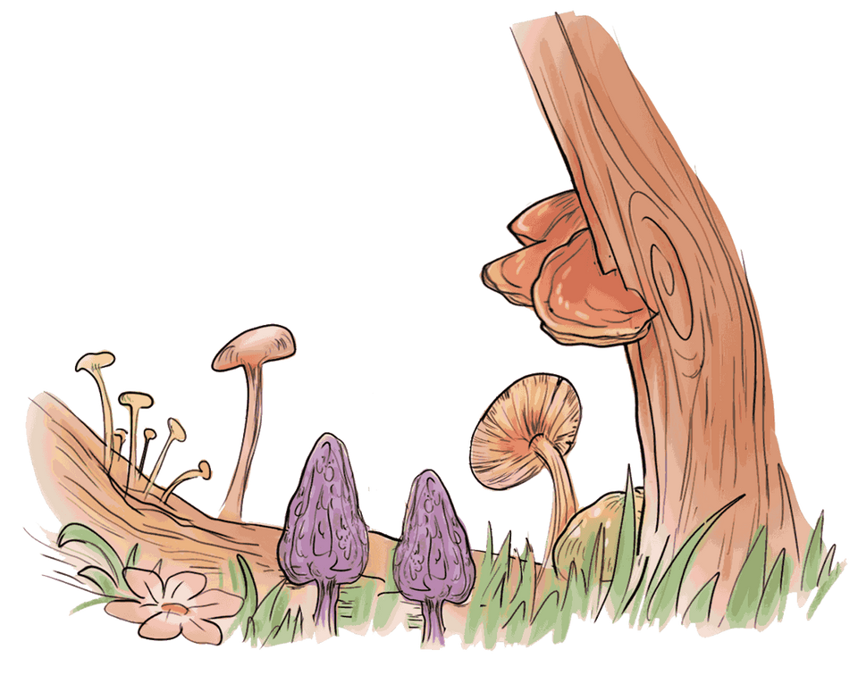

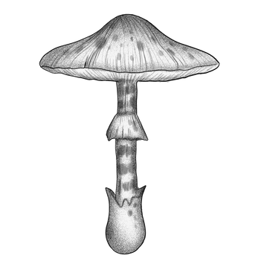


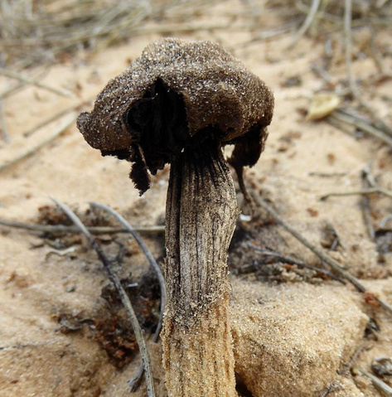
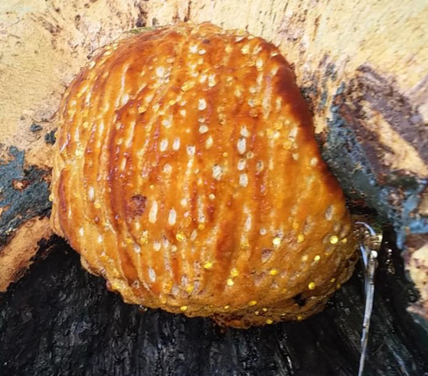
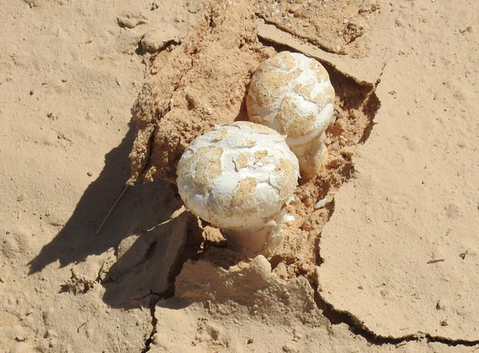
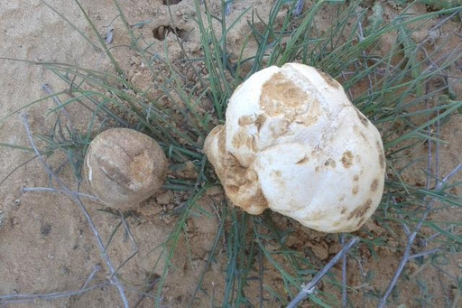
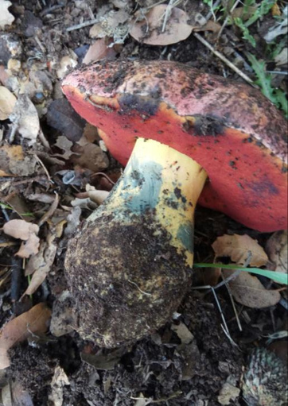
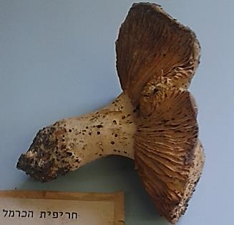
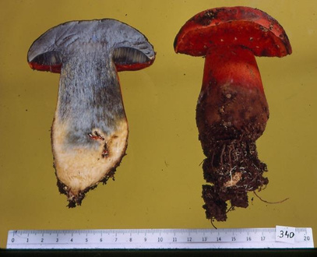
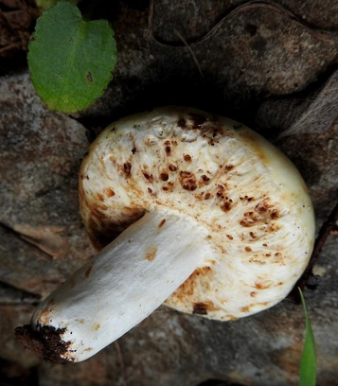


The fungi collection
The Steinhardt Museum of Natural History,
Tel Aviv University, Israel
The fungi herbarium is a comprehensive collection consisting mainly of mushrooms from Israel and the East-Mediterranean region. It is a unique collection that was founded by mycologist Nissan Binyamini in the 1960s, and continuous until 1992. His collection comprises approximately 6000 specimens among which 260 genera. It serves as the paramount referential work on fungi of Israel.
Montagnea candollei
Pseudoinonotus dryadeus
The collection comprises approximately 7500 specimens of fungi, conserved in paper envelopes under required conservation conditions. The collection encompasses species of ascomycetes, basidiomycetes mushrooms and slime molds, making it the largest mushroom collection of the Middle East. The herbarium is listed in Index Herbarium under the acronym TELA.
From 2016 to 2025 Bruria Gal added 1500 new specimens among which 150 genera of gilled and non-gilled mushrooms. These were collected mainly in the Judean hills around Jerusalem, the Carmel mountain near Haifa, as well as the Galil and Golan regions. In rainy seasons, unique species were collected in the Negev desert.
To support the morphological identification of the specimens, DNA was extracted, amplified using ITS1 and ITS4 and sequences were identified by performing a search against the nucleotide collection in GenBank. Sequences were submitted to GenBank.
Podaxis pistillaris
Terfezia boudieri + Tirmania
First ever described in Israel
Tirmania nivea + Terfezia
Exsudoporus permagnificus
Russula carmelensis
Boletus reichertii
Macowanites galileensis
The Steinhardt Museum of National History is Israel's national center for biodiversity studies. It collects and catalogues millions of specimens. Hundreds scientists, graduate students and professionals from Israel and abroad use the collections for basic and applied research in the fields of natural history and conservation.
Further details: smnh@tauex.tau.ac.il.

